Slide 1
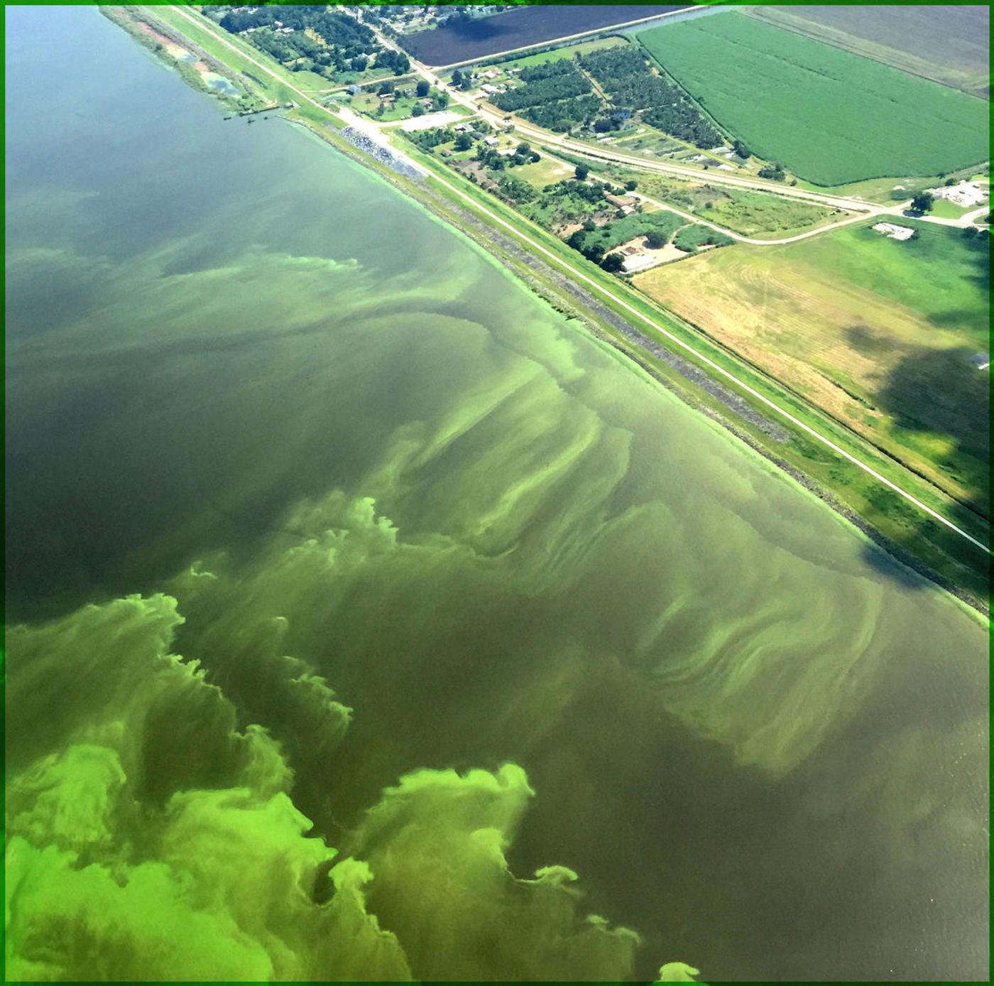
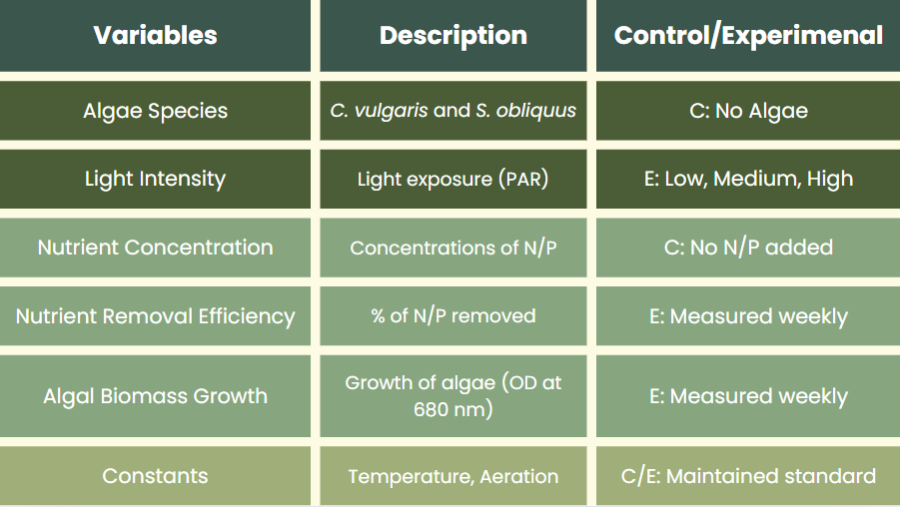
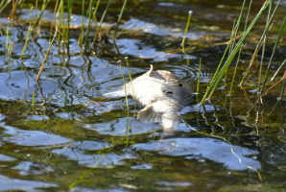
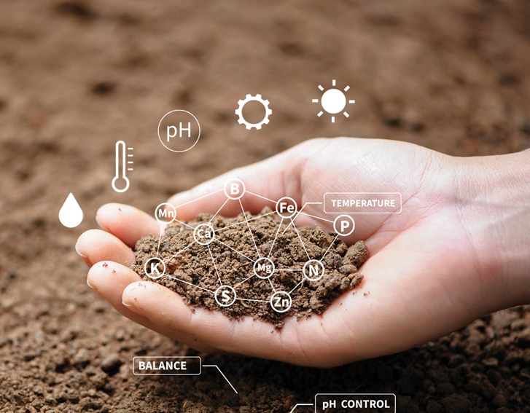
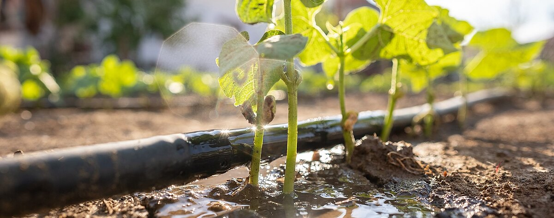
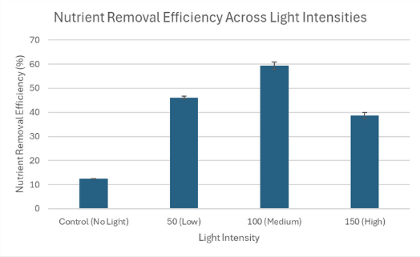
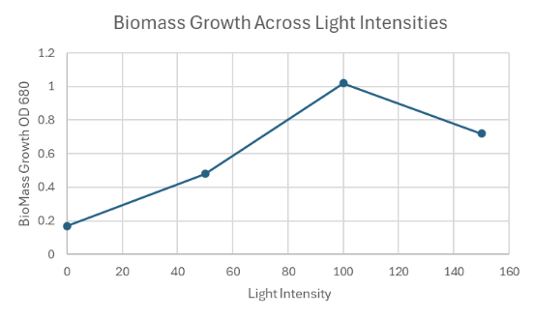
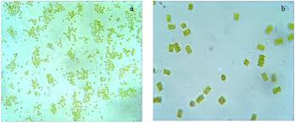
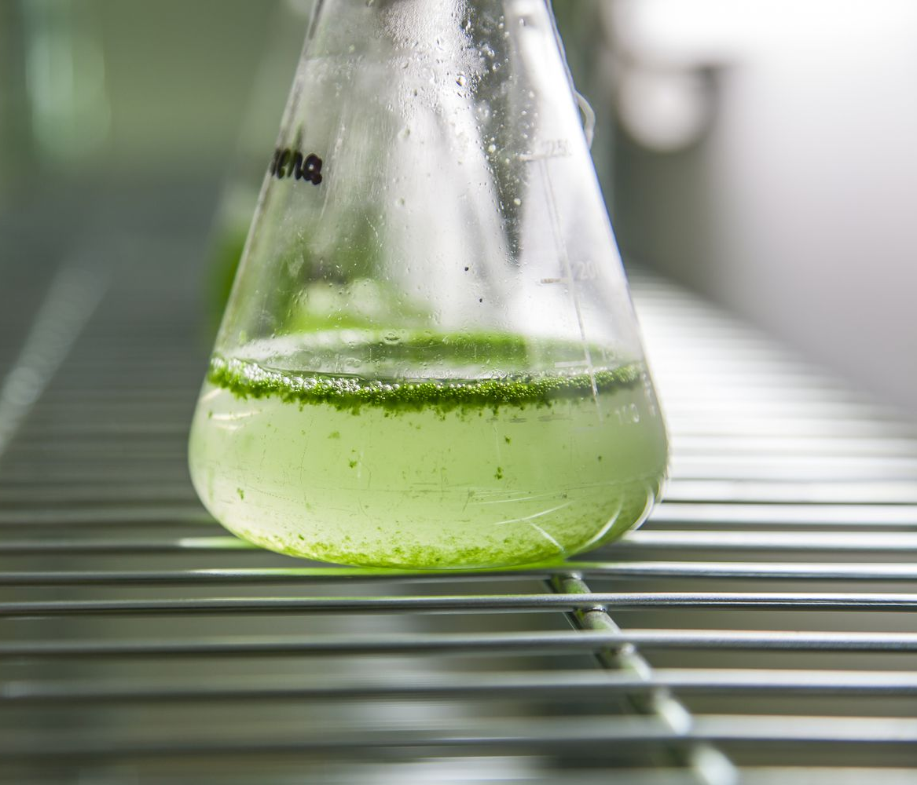
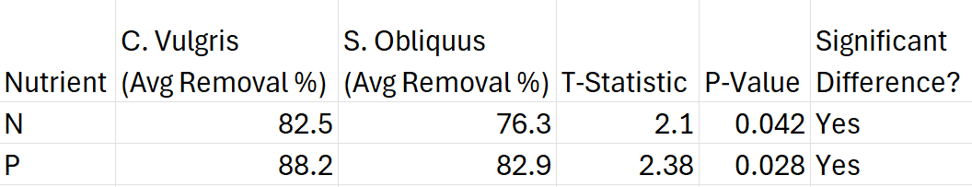
Optimizing Algal Biofilters For Nutrient Runoff Mitigation in Agricultural Systems
Sreepadha Daram
Research Question: How do C. vulgaris and S. obliquus perform as biofilters for agricultural runoff under fluctuating conditions, specifically light?
The Issue: Agricultural Runoff
Materials/Set-Up
Results
Conclusion
Agricultural runoff transports excess nitrogen and phosphorus, pesticides, and livestock waste into rivers, lakes, and groundwater.
This nutrient overload causes eutrophication, resulting in:
  Harmful algal blooms (HABs)
  Decreased oxygen levels (hypoxia)
  Massive fish kills and biodiversity collapse
  Runoff contamination also poses human health risks through drinking water and irrigation systems, potentially leading to conditions like blue baby syndrome.
Nutrient Removal Efficiency:
  The highest efficiency was observed at 100 μmol m⁻² s⁻¹ with a mean of 59.37% and a standard deviation of 1.14%, indicating consistent nutrient uptake. Efficiency dropped to 38.70% at 150 μmol m⁻² s⁻¹, likely due to photoinhibition, where excessive light hampers photosynthesis. The control group had the lowest uptake at 12.43%, while 50 μmol m⁻² s⁻¹ showed moderate removal at 45.97%.
Biomass Growth:
  Biomass followed a similar pattern, peaking at 100 μmol m⁻² s⁻¹, supporting optimal growth. Both lower (50) and higher (150) intensities resulted in reduced growth compared to the optimal condition.
Statistical Analysis:
  A 1-Way ANOVA returned p < 0.05 for both nutrient removal and biomass growth, confirming light intensity had a significant impact.
Species Comparison:
  A T-test showed C. vulgaris outperformed S. obliquus:
This study demonstrated that moderate light intensity (100 μmol m⁻² s⁻¹) maximizes both nutrient removal efficiency and biomass growth in algal biofilters, supporting the hypothesis that light intensity significantly influences algal performance.
Among the species tested, Chlorella vulgaris was significantly more effective than Scenedesmus obliquus in removing both nitrogen and phosphorus, suggesting it is a better candidate for nutrient mitigation in agricultural runoff systems.
However, limitations exist:
  The experiment used synthetic runoff, which may not fully replicate complex field conditions.
  Only two algal species and one nutrient ratio were tested.
  Environmental variables like pH fluctuations, microbial interference, and temperature variation were controlled, but could differ in real-world applications.
Economically:
  Increases water treatment costs for municipalities
  Reduces fishery productivity
  Damages tourism industries in affected regions
Methods and Procedures
The Solution: Algae as Biofilters
Inoculation and Culture Preparation
  Pure stock cultures of C. vulgaris and S. obliquus were grown in BG-11 nutrient medium under sterile conditions to ensure uncontaminated algal growth.
  Algae were inoculated into 500 mL glass beakers, each filled with sterile BG-11 and adjusted to an initial optical density (OD) of 0.2 at 680 nm, standardizing initial biomass across trials.
Stimulated Runoff Exposure
  A synthetic agricultural runoff solution was formulated with measured concentrations of nitrate and phosphate, mimicking typical nutrient loads found in real-world runoff.
  50 mL of runoff solution was added to each culture, and initial nitrogen and phosphorus levels were measured using colorimetric test kits or spectrophotometry.
Experimental Setup
  All cultures were maintained at constant room temperature (25°C) and continuously aerated using air pumps to ensure gas exchange and prevent algal settling.
  Beakers were placed in custom bioreactors exposed to three different light intensities (50, 100, 150 μmol photons m⁻² s⁻¹) using adjustable LED lamps with timer controls to simulate natural light cycles (12:12 hr).
  All cultures were kept in triplicate for each species and light condition to ensure reproducibility.
Data Collection
  Nutrient concentrations were recorded weekly using standard water testing methods (spectrophotometric kits or ion chromatography).
  Biomass growth was assessed weekly by measuring OD at 680 nm, providing a proxy for algal density.
  pH, temperature, and aeration were monitored daily to ensure experimental consistency.
Microalgae are photosynthetic organisms capable of rapid growth and high nutrient uptake, making them ideal for bioremediation. They remove excess nitrogen (N) and phosphorus (P) from contaminated water via:
  Biological assimilation (absorbing nutrients into their cells)
  Metabolic transformation into biomass, which can be harvested and potentially reused
Advantages of Using Algae:
  Cost-effective: Requires only sunlight, CO₂, and basic nutrients; low operational costs compared to chemical treatments
  Environmentally friendly: Produces oxygen, sequesters carbon, and leaves no toxic byproducts
  Scalable: Can be integrated into ponds, ditches, wetlands, or even modular bioreactors near farms
Species in Focus:
  Chlorella vulgaris:
    Fast-growing green microalga with high nitrogen and phosphorus removal rates
    Known for tolerance to varying light and nutrient conditions
  Scenedesmus obliquus:
    Robust microalga commonly found in freshwater ecosystems
    Recognized for forming colonies that enhance nutrient uptake and settling efficiency
Existing Research:
  Numerous studies demonstrate their efficacy under controlled lab settings:
  C. vulgaris has shown up to 90% phosphate removal in batch systems
  S. obliquus effectively reduces ammonium and nitrate concentrations over time
However, real-world implementation is limited by:
  Inconsistent results under natural light variations
  Lack of large-scale field trials or comparative studies across multiple species and environments
Research Gap Addressed by This Study: How do C. vulgaris and S. obliquus perform as biofilters for agricultural runoff under fluctuating conditions, specifically light?
Next Steps
Implications:
Cost-Effective Remediation: Algae systems reduce reliance on chemical treatments and energy-intensive wastewater infrastructure, offering a low-cost, low-maintenance alternative, particularly beneficial for small or resource-limited farms.
Environmental Benefits: Algal biofilters not only absorb excess nitrogen and phosphorus, but also restore oxygen levels in eutrophic waters, helping mitigate harmful algal blooms and dead zones in aquatic ecosystems.
Implementation:
Enhanced Biomass Quantification: Include dry weight biomass measurements alongside optical density to better estimate algal productivity and nutrient uptake potential.
Complex Runoff Testing: Evaluate algal performance in realistic water samples containing additional pollutants like heavy metals, herbicides, and organic matter, mimicking actual runoff conditions.
Broader Species Screening: Test additional algal species or synergistic species consortia that could improve nutrient capture, stress tolerance, or adaptability across diverse environmental conditions.
Field-Scale Trials: Deploy algae biofilters in runoff ditches, retention ponds, or constructed wetlands to validate lab findings under real-world conditions and over longer durations.
Policy and Infrastructure Collaboration: Partner with policymakers, engineers, and environmental agencies to incorporate algae biofilters into green infrastructure initiatives. This could open pathways for pilot programs, public-private partnerships, and funding opportunities to drive large-scale adoption.

