Slide 1
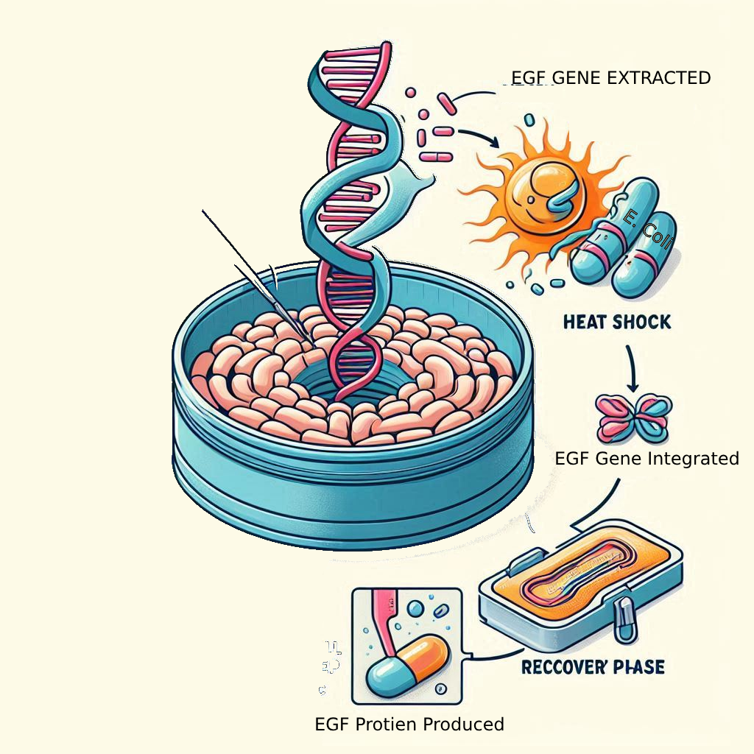
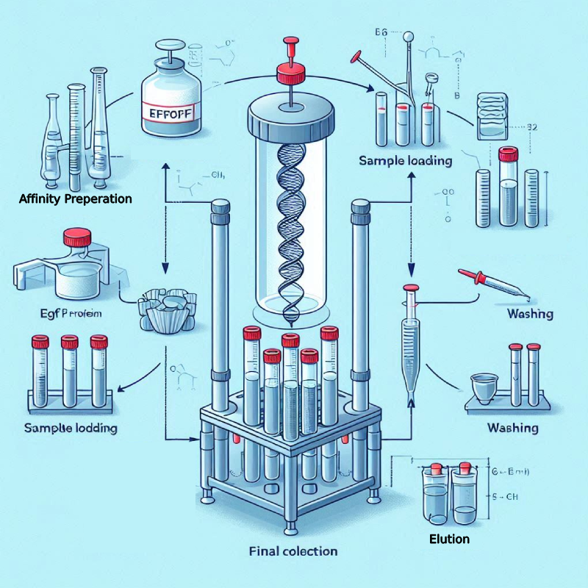

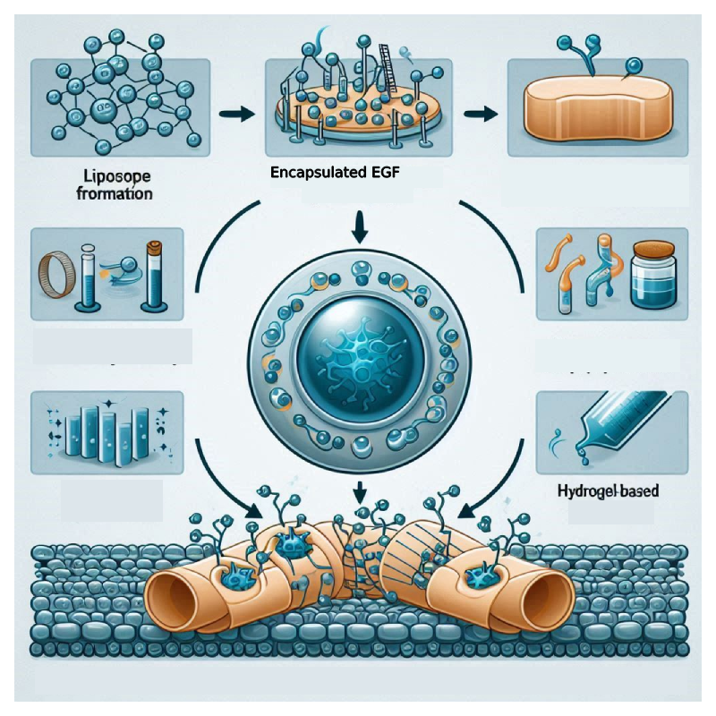
EGF-Integrated Bandage Technology
Tyce Crafford and Araav Nath
Biomedical Engineering Club, Innovation Academy
Labeled Diagram Procedure
Abstract:
Acute and chronic wounds, such as small epidermal abrasions and burns, often experience delayed healing due to slow tissue regeneration. Traditional bandages provide only physical coverage and lack biological support to accelerate the healing process. To address this limitation, the feasibility of a liposome-based Epidermal Growth Factor (EGF) delivery system incorporated into a standard bandage was investigated to determine its potential to enhance tissue regeneration and prevent scarring. EGF was obtained through recombinant expression of the EGF gene in E. coli, followed by affinity chromatography purification to isolate bioactive EGF. The purified protein was then encapsulated within phospholipid liposomes, enabling controlled release and ensuring prolonged exposure at the wound site. This sustained delivery mechanism enhances keratinocyte proliferation, promoting faster wound closure and improved tissue recovery.
Methodology:
The EGF gene is inserted into expression vector known as pET, under the promoter T7. The reason for using the pET expression vector is because it allows for very high-level production of proteins of interest (VectorBuilder, n.d.). The expression vector is then inserted into the bacteria via heat shock, a process in which a transformation temporarily disrupts the bacterial membrane, allowing plasmid DNA to enter before rapid cooling restores membrane integrity.
Once the transformed E. coli expresses the EGF, the next step is cell lysis to release the desired protein. The lysate is then centrifuged at high speed to separate the insoluble debris from the soluble fraction containing recombinant EGF. The reason for these steps is to separate the E. coli cell from the protein allowing use of the EGF protein without contamination of the E. coli cell.
Purification Of EGF Protein:
After the EGF protein is extracted, it is purified using affinity chromatography. Affinity chromatography is based on purification based on the binding interaction with a ligand. It selectively isolates the target molecule from a complex mixture by exploiting its biochemical affinity (M et al., 2009). This purification process will allow for high purity isolation based on specific interactions. This will allow for a retention of bioactivity which maybe lost in other purification methods.
Liposome Excipient:
The reason for excipient in topical creams is to allow for the uniform application of the active ingredients on the skin, like the EGF protein. A liposome is an excipient structured as a spherical vesicle that encapsulates EGF protein, protecting them from degradation and facilitates them through the skin’s barrier (Gao et al., 2013). This leads to better absorption and expression of the gene in the epidermis due to more efficient transport in Epidermis.
To create a liposomal mix for a homologous cream, dissolve phospholipids, form liposomes by hydrating and sonication, process that uses sound waves to agitate particles in a liquid or other medium, mix the active ingredients, and combine with a EGF protein to achieve homogeneous formulation.
Inclusion of Liposomal EGF into Bandage
The liposomal EGF are encapsulated within a hydrogel matrix. Hydrogels are used in wound healing because they mimic the extracellular matrix, provide moisture retention. Their ability to regulate EGF release ensures sustained exposure at the wound site, preventing rapid degradation while promoting tissue regeneration makes them the ideal choice for incorporating (Gurtner Lab, n.d.).
This newly cultured hydrogel with EGF’s proteins in them would be applied to the thin layer to the antiseptic pad of the bandage. This would make it so the area of impact would receive the benefits of the external EGF while also being protected from pathogens.
X`
Cultivation and Transinfection Of EGF Protein Via E. Coli:
Background
Background Information on EGF-Based Wound Healing Innovations
Delayed Healing in Acute and Chronic Wounds
Small epidermal abrasions and burns often experience slow tissue regeneration.
Traditional bandages provide physical protection but lack biological support to enhance recovery.
Role of Epidermal Growth Factor (EGF) in Wound Healing
EGF is a key signaling molecule that stimulates keratinocyte proliferation and tissue regeneration.
Binds to Epidermal Growth Factor Receptor (EGFR), triggering kinase activation and phosphorylation.
Leads to cell proliferation, survival, and accelerated wound closure.
Proven Effectiveness of EGF in Healing
Studies show that topical EGF application stimulates epithelialization and improves
early wound repair.
Research involving pig models demonstrated enhanced epidermal regeneration.
Current Medical Applications of EGF
Used in burn treatment, ulcer care, and post-surgical wound recovery.
Applied to minimize scarring and improve skin texture in cosmetic dermatology.
Advancements in EGF Delivery for Bandages
Recombinant EGF production via gene cloning in E. coli.
Purification through affinity chromatography for high bioactivity.
Encapsulation within phospholipid liposomes to ensure sustained release and protection.
Integration of Liposomal EGF into Hydrogel Bandages
Hydrogels mimic the extracellular matrix and retain moisture.
Liposomal EGF within hydrogel layers ensures prolonged exposure at the wound site.
Potential to revolutionize wound care by combining physical protection with bioactive
healing properties.
Purification via Affinity Chromatography
Incorporation Into A Liposome and Hydrogel

