Slide 1


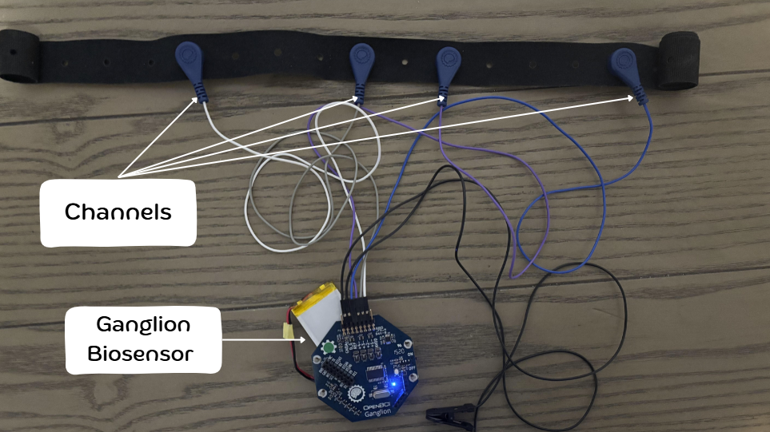
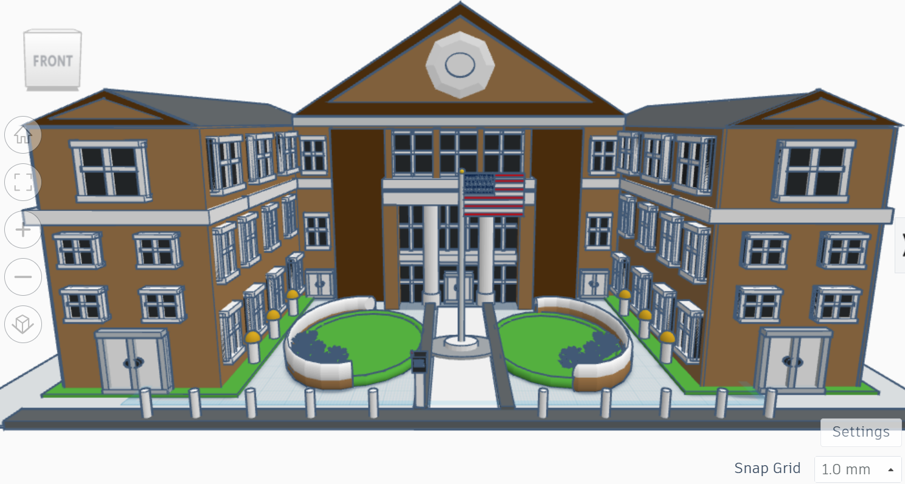
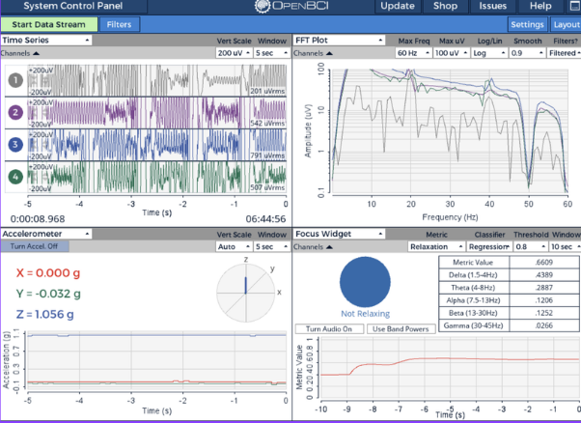
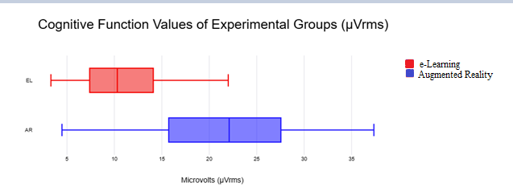
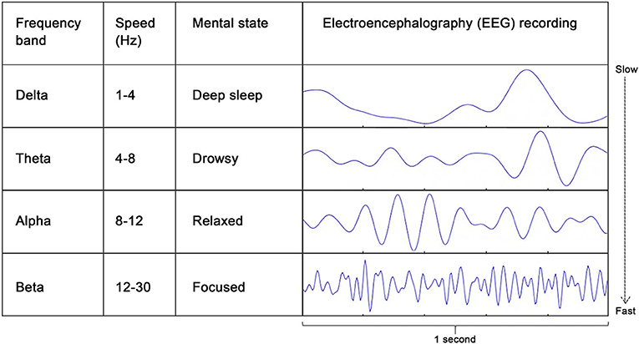
2D vs. Reality: The Impact of Augmented Reality and eLearning on the Cognitive Function and Academic Performance of Students
Mariam Hussain (11th Grade)
Mariam Hussain (11th Grade)
How do the different structures of Augmented Reality (AR) and eLearning (EL) technology impact the cognitive function and academic performance of students within the school environment?
Primary Alternate Hypothesis One (Ha.0): AR technology has a significant impact on the cognitive function of students within the school environment that differs from eLearning technology.
Secondary Alternate Hypothesis One (Ha.1): If AR technology has an impact on cognitive function, results of academic performance will also differ significantly to eLearning technology
Experimental Research Design:
Independent Variable: Technology group (AR or EL) with ~30 participants for each
Dependent Variable: Resulting Cognitive Function and Academic Performance Values
Cognitive Function Assessment:
OpenBCI Electroencephalogram (EEG) Headband Kit + Ganglion Biosensor
Brainwaves measured in microvolts (µVrms) for an average of ~2 minutes on OpenBCI App
Academic Performance Assessment:
Pre- and Post-Tests through Microsoft Forms
Memory as a test of academic performance (Blankenship et al., 2015)
AR Technology Component:
3D school building model created through Tinkercad
Displayed with AR technology using Adobe Aero App
EL Technology Component:
Nearpod lesson with 3 goals:
Interactive features
School building discussion
Similar structure to lessons used for EL in classrooms
*α-value = 0.05
Cognitive Function:
p-value: 1.6 x 10^-7
p-value < α-value
Fail to reject Ha.0
A significant difference is noted between the impact of AR and EL technology on the cognitive function of students
Academic Performance (Pre- and Post-Tests):
p-values:
Pre-Test: 0.78557
Post-Test: 0.007198922
Both Tests: p-value > α-value
Reject Ha.1
No significant difference is noted between the impact of AR and EL technology on the academic performance of students
Research Question
Methodology
Analysis
3D Building Model
Cognitive Function Set-Up
History of AR Technology:
1968: first AR technology designed by Harvard computer scientist Ivan Sutherland; “Sword of Damocles” (Sutherland, 1965)
1982: VCASS – United States Airforce AR simulator (Kocian, 1977)
2016: Pokémon GO; AR in popular culture (Marto & Gonçalves, 2022)
2020: AR and surgical procedures (John Hopkins University, 2021)
EL Technology Within the Classroom:
Decrease in attention span of students; 45% from initial 80% (Bhattacharya et al., 2022)
Increase in grades (110%) and standard deviation of test scores (+0.20) (Akpen et al., 2024; Clark et al., 2021)
EL methods: Decreasing alpha2-beta waves and unstable increase in delta, theta and alpha waves (Conrad & Newman, 2021; Ham, 2017)
AR Technology Within the Classroom Consideration:
AR use leads to increased comfort in learning (AlNajdi, 2022)
AR technology and anxiety reduction (Rojas-Contreras et al., 2021)
Potential negative effects if implementation is not explicitly studied (Al-Ansari et al., 2023)
Background
Findings:
AR and EL technology have statistically different impacts on cognitive function for student learning
AR technology demonstrates higher levels of cognitive function; cause relates to immersive components
AR technology activates different senses and sensory inputs; has an impact on reported cognitive function levels of students
Limitations:
Sensitivity of Ganglion Biosensor (somatic movements/wind)
Learning styles/characterizations of students
Implications:
Introduction in early education to improve progression of educational hierarchy
Environmental impact of classroom on utilization of AR
Personal factors of students impacting utilization of AR
Cognitive Function:
*All measurements in µVrms
Averages (µVrms/2 mins.):
AR Technology Group: 22.16091667
EL Technology Group: 11.06108333
Academic Performance:
*Tests scored out of 10
Discussion
Results
 | AR Technology Group | EL Technology Group
Maximum | 4.475 | 3.31
Minimum | 34.33 | 17.75
Median | 22.098 | 10.309
Quartile 1 | 16.233 | 7.596
Quartile 3 | 27.406 | 14.048
IQR | 11.173 | 6.453
Statistical Test:
*Welch’s T-Test (Unequal Variance)
Cognitive Function:
Acknowledgements
dF | T-Stat | P(T<=t) one-tail | P (T<=t) two-tail
1 | 6.21941 | 8E-08 | 1.6E-07
Akpen, C. N., Asaolu, S., Atobatele, S., Okagbue, H., & Sampson, S. (2024). Impact of online learning on student’s performance and engagement: a systematic review. Discover Education, 3(1). https://doi.org/10.1007/s44217-024-00253-0
Al-Ansi, A. M., Jaboob, M., Garad, A., & Al-Ansi, A. (2023). Analyzing Augmented Reality (AR) and Virtual Reality (VR) Recent Development in Education. Social Sciences & Humanities Open, 8(1), 100532. https://doi.org/10.1016/j.ssaho.2023.100532
AlNajdi, S. M. (2022). The effectiveness of using augmented reality (AR) to enhance student performance: using quick response (QR) codes in student textbooks in the Saudi education system. Educational Technology Research and Development, 70. https://doi.org/10.1007/s11423-022-10100-4
Bhattacharya, S., Murthy, V., & Bhattacharya, S. (2022). The social and ethical issues of online learning during the pandemic and beyond. Asian Journal of Business Ethics, 11(1), 275–293. https://doi.org/10.1007/s13520-022-00148-z
Blankenship, T. L., O’Neill, M., Ross, A., & Bell, M. A. (2015). Working memory and recollection contribute to academic achievement. Learning and Individual Differences, 43(43), 164–169. https://doi.org/10.1016/j.lindif.2015.08.020
Clark, A. E., Nong, H., Zhu, H., & Zhu, R. (2021). Compensating for academic loss: Online learning and student performance during the COVID-19 pandemic. China Economic Review, 68, 101629. https://doi.org/10.1016/j.chieco.2021.101629
Conrad, C., & Newman, A. (2021). Measuring Mind Wandering During Online Lectures Assessed With EEG. Frontiers in Human Neuroscience, 15. https://doi.org/10.3389/fnhum.2021.697532
Ham, B. (2017, October 11). Brain waves reflect different types of learning. MIT News | Massachusetts Institute of Technology. https://news.mit.edu/2017/brain-waves-reflect-different-types-learning-1011
Huri, S., Chintamani, A., & Cutting, K. (2024). The Impact Of Augmented Reality On Teaching And Learning In The Educational Context: Exploring Its Pedagogical Implications. Educational Administration Theory and Practice, 30(05)(2148-2403). https://doi.org/10.53555/kuey.v30i5.3902
John Hopkins University. (2021, February 16). Johns Hopkins Performs Its First Augmented Reality Surgeries in Patients. Www.hopkinsmedicine.org. https://www.hopkinsmedicine.org/news/articles/2021/02/johns-hopkins-performs-its-first-augmented-reality-surgeries-in-patients
Marto, A., & Gonçalves, A. (2022). Augmented Reality Games and Presence: A Systematic Review. Journal of Imaging, 8(4), 91. https://doi.org/10.3390/jimaging8040091
Rojas-Contreras, Peña-Cortés, C. A., & Moreno-Cuevas, L. A. (2021). Analysis of Cognitive States in Response to Stimuli from Augmented Reality Applications for Teaching Physics. Journal of Physics Conference Series, 2102(1), 012004–012004. https://doi.org/10.1088/1742-6596/2102/1/012004
Sutherland, I. (1965). The Ultimate Display. https://worrydream.com/refs/Sutherland_1965_-_The_Ultimate_Display.pdf
Academic Performance (Pre-Test):
dF | T-Stat | P(T<=t) one-tail | P (T<=t) two-tail
1 | 0.392785646 | 1.67202 | 0.78557
Academic Performance (Post-Test):
dF | T-Stat | P(T<=t) one-tail | P (T<=t) two-tail
1 | 2.789630305 | 0.003599461 | 0.007198922

