Slide 1

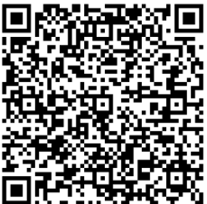
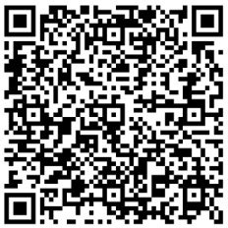
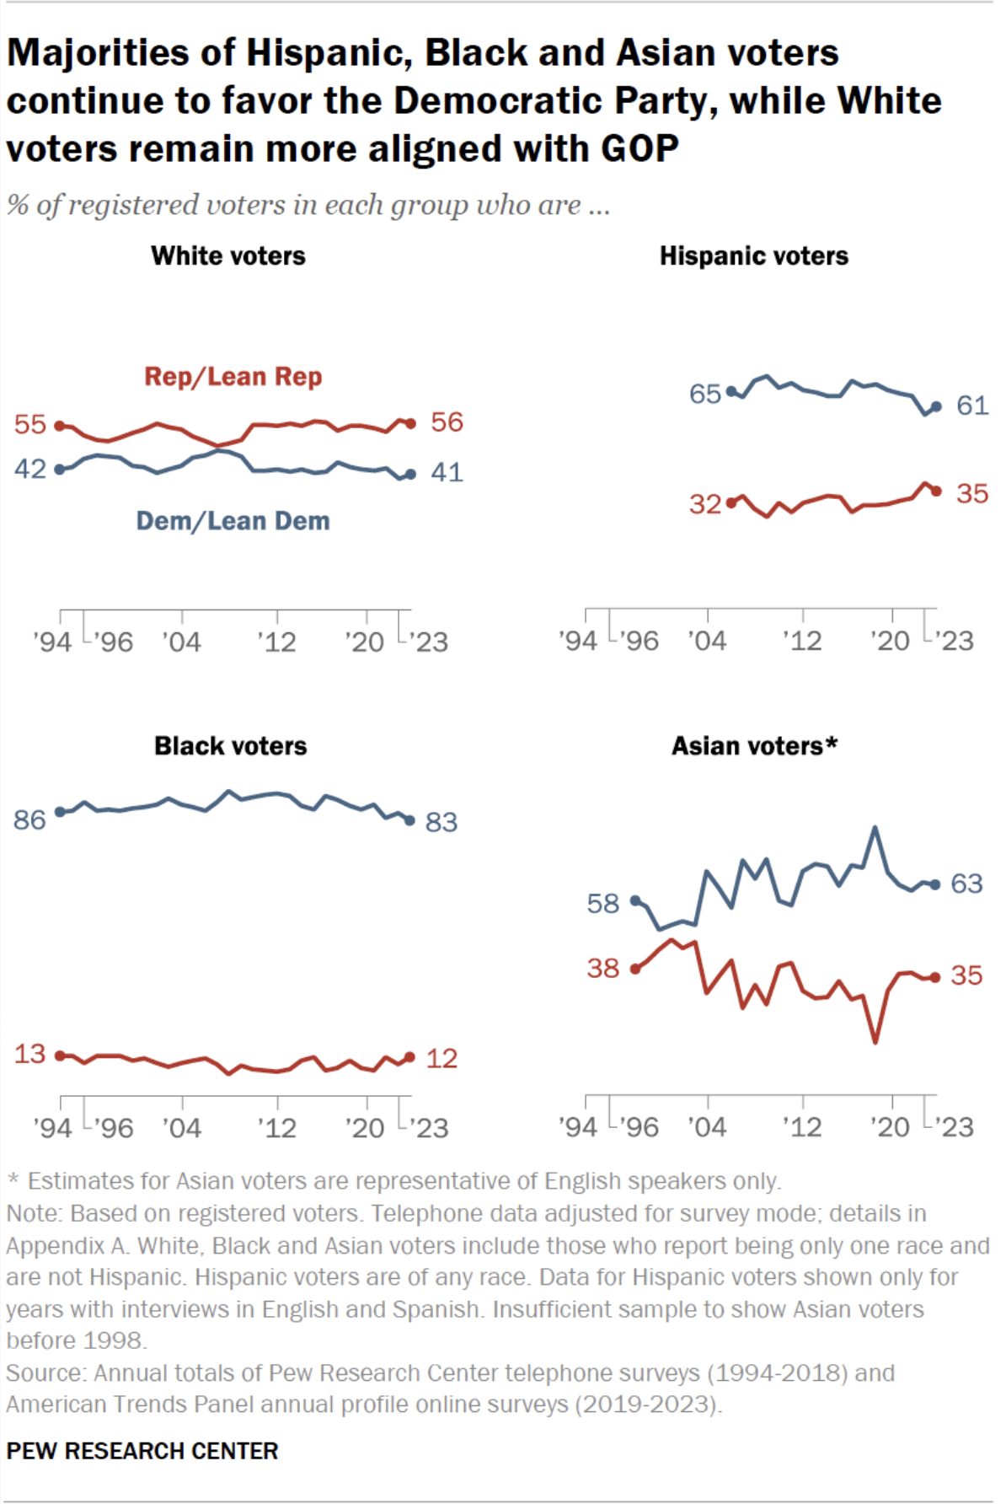
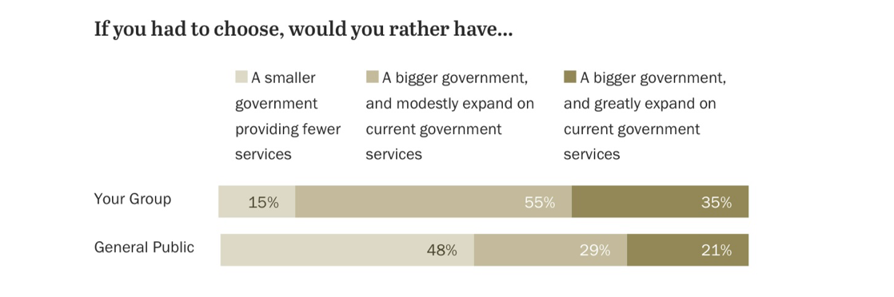
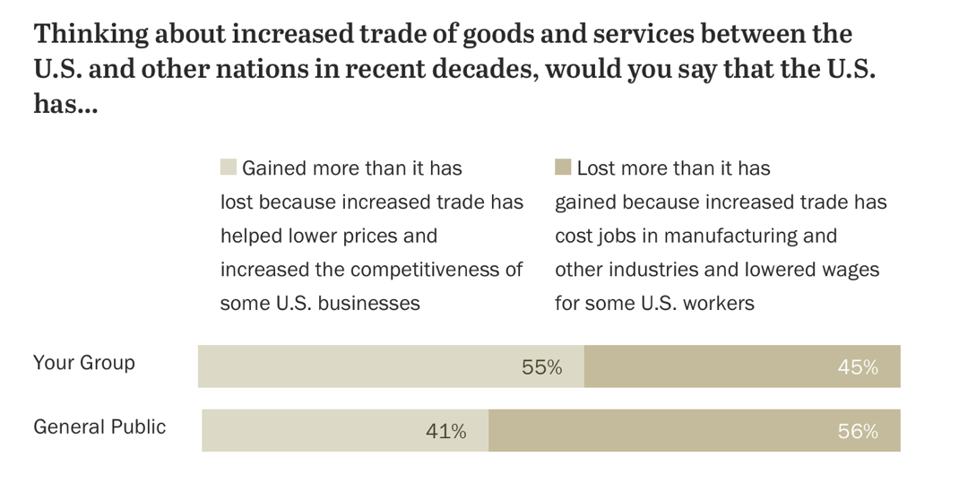
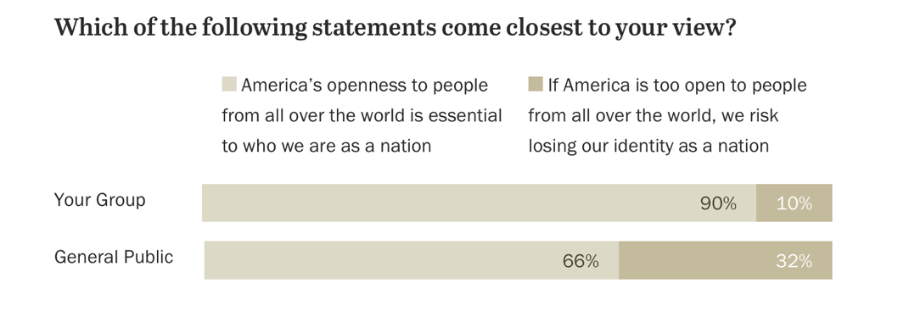
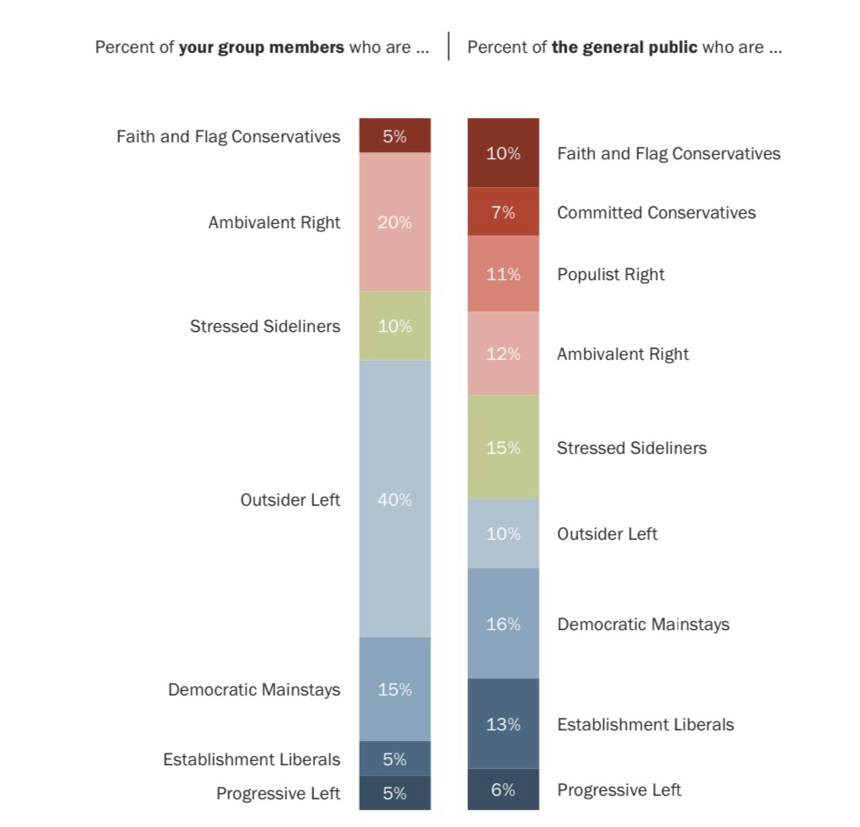
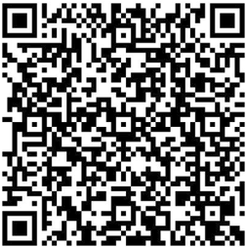
Bilingualism’s Impact on Social Perception and Political Views
Vasumathi Rajaji
Innovate: IA Project Showcase
Abstract
Materials
Results
Conclusion
Investigates how bilingualism influences political views and voting behavior, focusing on future implications for U.S. democracy
Targets Latino and Asian-American bilingual youth (ages 14–35) to explore links between language use and civic identity
Mixed-methods approach was used, combining historical voting data (1996–2020) with surveys measuring attitudes toward policy, identity, and participation
The hypothesis: bilingualism fosters greater cognitive flexibility, empathy, and openness, leading to higher voter engagement and progressive values.
Results reveal bilingual participants align with moderate (socially progressive & conservative economic) typologies, indicating a pragmatic approach to politics.
Support that bilinguals are uniquely positioned to influence electoral shifts due to their dual cultural fluency
Data sources: U.S. Census Bureau registration data, Pew Research Center political surveys, and bilingual community databases.
Participants were divided by language status: 50 bilingual and 50 monolingual individuals representing major ethnic groups.
Survey instruments included: Political Typology Quiz, Likert-scale questions on diversity, immigration, and economic priorities.
Statistical tools used: chi-square tests for group comparison, regression analysis for predicting ideological alignment.
Visual data charts and typology breakdowns supported triangulation of findings across survey and historical data.
Phase 1:
Bilingualism plays a significant and complex role in shaping political identity, especially in younger populations
Confirms that bilingual individuals tend to be more civically aware and open to socially progressive policies
Exhibit cognitive traits such as perspective-taking and empathy, enhancing their ability to navigate polarized political landscapes
Support inclusive immigration policies, social justice reform, and diplomacy-focused foreign relations
Intersection of language and identity encourages participation in civic life and nuanced interpretations of political messaging
Voters favor candidates who respect cultural diversity while maintaining practical economic policies.
Political platforms and strategies will need to evolve to engage this increasingly influential demographic group.
Research demonstrates the importance of including language proficiency in discussions of political forecasting and voter engagement.
Methodology
Recommendations
Phase 1:
  Historical data analysis included voter turnout and party affiliation by race/language group from national elections.
  Chi-square and regression tests evaluated correlations between language use and partisan alignment across decades.
Phase 2:
  Surveys collected from 100 participants measured current views on policy, social justice, immigration, and ideology.
  Bilingualism was operationalized by self-report and use of multiple languages at home, work, or school.
  Recruitment focused on high schools, colleges, and bilingual communities to ensure demographic representation.
  Participants completed typology quizzes and open-ended questions about political priorities and cultural values
  Descriptive statistics provided mean values for political alignment
  Inferential tests revealed significant differences by language group
  Two-pronged approach ensured both longitudinal and real-time perspectives were included in the analysis
Phase 2
Integrate bilingual education with civic instruction to develop informed, empathetic, and globally minded future voters
Campaigns should use bilingual media and culturally relevant messaging to engage diverse linguistic communities authentically.
Conduct long-term studies that track bilingual individuals from adolescence to adulthood to measure political identity formation.
Incorporate language background into political typology models and survey instruments for greater demographic accuracy.
Promote policies that protect language rights and support dual-language learning as civic infrastructure.
Explore how social media algorithms affect bilingual political behavior and the spread of multicultural discourse.
Political scientists should further analyze swing state dynamics in districts with growing bilingual populations.
Develop targeted outreach strategies for bilingual youth who may be eligible to vote in the next decade.
Introduction
Bilingualism, defined as fluency in two or more languages, is increasingly common among young Americans in multicultural communities.
In addition to cognitive benefits, bilingualism fosters emotional intelligence, cross-cultural understanding, and civic responsibility.
Latino and Asian-American communities, the fastest-growing bilingual groups, are reshaping the political landscape with distinct perspectives.
Language is more than a tool for communication—it is a carrier of cultural identity and social values.
Previous research has focused on short-term cognitive advantages; this study shifts the focus to long-term civic implications.
The study proposes that bilinguals are more likely to engage in politics, vote, and support inclusive policies.
Bilinguals’ access to diverse media and ability to navigate multiple worldviews equips them with complex political insight.
Acknowledgements

